Slide 1
22C:19 Discrete Math Discrete Probability
Spring 2014
Sukumar Ghosh

Slide 2
Sample Space
DEFINITION. The sample space S of an experiment is the set
of possible outcomes. An event E is a subset of the sample space.

Slide 3
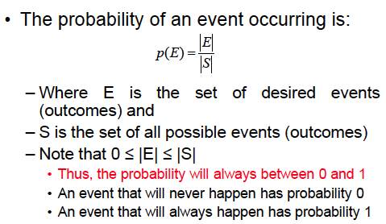
What is probability?

Slide 4
Probability distribution
Consider an experiment where there are n possible outcomes
x₁, x₂, x₃, x₄, … x_{n} . Then
1. 0 ≤ p(x₁) ≤ 1
2. p(x₁) + p(x₂) + p(x₃) + p(x₄) + … + p(x_{n}) = 1
You can treat p as a function that maps the set of all outcomes to
the set of real numbers. This is called the probability distribution
function.

Slide 5
Probability of independent events
When two events E and F are independent, the occurrence of one gives no information about the occurrence of the other.
The probability of two independent events
p(E∩F) = p(E) . p(F)

Slide 6
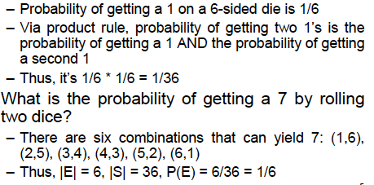
Example of dice
What is the probability of two 1’s on two six-sided dice?

Slide 7
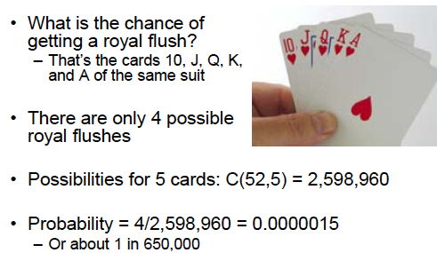
Poker game: Royal flush

Slide 8
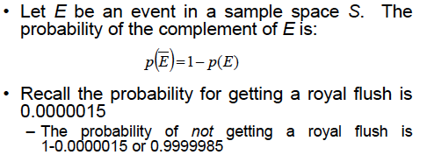
More on probability

Slide 9
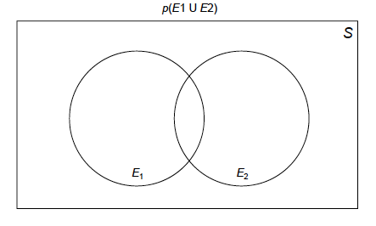
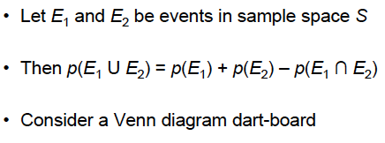
Probability of the union of events

Slide 10
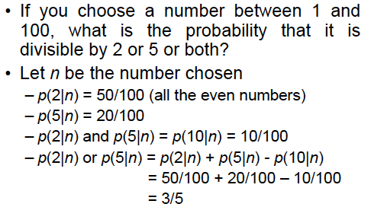
Example

Slide 11
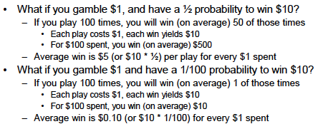
When is gambling worth?
Disclaimer. This is a statistical analysis, not a moral or
ethical discussion

Slide 12
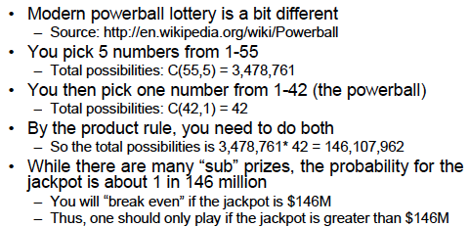
Powerball lottery
Disclaimer. This is a statistical analysis, not a moral or
ethical discussion

Slide 13
Conditional Probability
You are flipping a coin 3 times. The first flip is a tail. Given
this, what is the probability that the 3 flips produce an odd
number of tails?
Deals with the probability of an event E when another event
F has already occurred. The occurrence of F actually shrinks
the sample space.
Given F, the probability of E is
p(E|F) = p(E ⋂ F) / p(F)

Slide 14
Conditional Probability
F= {TTT, THH, THT, TTH}
E= {TTT, THH}
p(E ⋂ F) = 2/8,
p(F) =4/8.
So p(E|F) = p(E ⋂ F) / p(F) = 1/2

Slide 15
Example of Conditional Probability
What is the probability that a family with two children has
two boys, given that they have at least one boy?
F = {BB, BG, GB}
E = {BB}
If the four events {BB, BG, GB, GG} are equally likely, then
p(F) = ¾, and p(E ⋂ F) = ¼
So the answer is ¼ divided by ¾ = 1/3

Slide 16
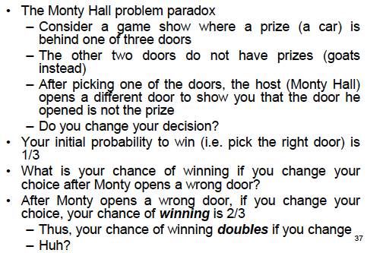
Monty Hall 3-door Puzzle

Slide 17
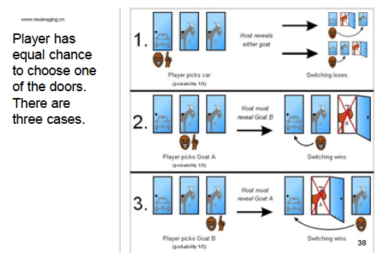
What is behind door number 3?

Slide 18
Bernoulli trials
An experiment with only two outcomes (like 0, 1 or T, F) is called a Bernoulli trial . Many problems need to compute the probability of exactly k successes when an experiment consists of n independent Bernoulli trials.

Slide 19
Bernoulli trials
Example. A coin is biased so that the probability of heads is 2/3. What is the probability that exactly four heads come up when the coin is flipped exactly seven times?

Slide 20
Bernoulli trials
The number of ways 4-out-of-7 flips can be heads is C(7,4).
H H H H T T T
T H H T H H T
T T T H H H H
Each flip is an independent flips. For each such pattern, the probability of 4 heads (and 3 tails) = (2/3)⁴. (1/3)^{3.} So, in all, the probability of exactly 4 heads is C(7,4). (2/3)⁴. (1/3)³ = 560/2187

Slide 21
Random variables
DEFINITION. A random variable is a function from the sample space of an experiment to the set of real numbers
Note. A random variable is a function, not a variable ☺
Example. A coin is flipped three times. Let X(t) be the random variable that equals the number of heads that appear when the outcome is t. Then
X(HHH) = 3
X(HHT) = X(HTH) = X(THH) = 2
X(TTH) = X(THT) = X(HTT) = 1
X(TTT) = 0

Slide 22
The Birthday Problem
The problem. What is the smallest number of people who should be in a room so that the probability that at least two of them have the same birthday is greater than ½?
3
2
1
Consider people entering the room one after another. Assuming birthdays are randomly
assigned dates, the probability that the second person has the same birthday as the
first one is 1 - 365/366
Probability that third person has the same birthday as any one of the previous persons is
1 – 364/366 x 365/366

Slide 23
The Birthday Problem
Continuing like this, probability that the n^{th} person has the same birthday as one of the previous persons is 1 – 365/366 x 364/366 x … x (367 –n)/366
3
2
1
Solve the equation so that for the n^{th} person, this probability
exceeds ½. You will get n = 23
Also sometimes known as the birthday paradox.

Slide 24
Expected Value
Informally, the expected value of a random variable is its average value. Like, “what is the average value of a Die?”
DEFINITION. The expected value of a random variable X(s) is equal to ∑_{s∈S} p(s)X(s)
EXAMPLE 1. Expected value of a Die
Each number 1, 2, 3, 4, 5, 6 occurs with a probability 1/6. So the expected value is 1/6 (1+2+3+4+5+6) = 21/6 = 7/2

Slide 25
Expected Value (continued)
EXAMPLE 2. A fair coin is flipped three times. Let X be the random variable that assigns to an outcome the number of heads that is the outcome. What is the expected value of X?
There are eight possible outcomes when a fair coin is flipped three times. These are HHH, HHT, HTH, HTT, THH, THT, TTH, TTT. Each occurs with a probability of 1/8. So,
E(X) = 1/8(3+2+2+2+1+1+1+0) = 12/8 = 3/2

Slide 26
Geometric distribution
Consider this:
You flip a coin and the probability of a tail is p. This coin is repeatedly flipped until it comes up tails. What is the expected number of flips until you see a tail?

Slide 27
Geometric distribution
The sample space {T, HT, HHT, HHHT …} is infinite.
The probability of a tail (T) is p.
Probability of a head (H) is (1-p)
The probability of (HT) is (1-p)p
The probability of (HHT) is (1-p)²p etc. Why?
Let X be the random variable that counts the number of flips to see a tail. Then p (X=j) = (1-p)^{j-1}. p
This is known as geometric distribution.

Slide 28
Expectation in a Geometric distribution
X = the random variable that counts the number of flips to see a tail.
So, X(T) = 1, X(HT) = 2, X(HHT) = 3 and so on.
E(X) = ∑∞₁ j. p(X=j) = ∑∞₁ j. (1-p)^{j-1}.p
= 1. p + 2.(1-p).p + 3.(1-p)².p + 4. (1-p)³.p +
This infinite series can be simplified to 1/p.
Thus, if p = 0.2 then the expected number of flips after which you see a tail is 1/0.2 = 5

Slide 29
Explanation
Probability | Value
0.2 0.3 0.5 | 30 40 20
What is the average value?
0.2 x 30 + 0.3 x 40 + 0.5 x 20 = 28

Slide 30
Expected value of a geometric distribution
Probability | Value of random variable X
p (1-p).p (1-p)².p (1-p)³.p .. | 1 2 3 4 ..
What is the average value (same as the expected value) of
the random variable X?
p + 2p(1-p) + 3p(1-p)² + 4p(1-p)³+ … = 1/p

Slide 31
Monte Carlo Algorithms
A class of probabilistic algorithms that make a random choice at one
or more steps.
Example. Has this batch of chips not been tested by the chip maker?
Randomly pick a chip and test it. If it is bad then the answer is yes. If
The chip is good then the answer is “I don’t know,” and then randomly
pick another. After the answer is yes for k different random picks, and
each time the answer is “I don’t know,” you certify the batch to be
good (that is, it has been tested by the chip maker).
What is the probability of a wrong conclusion?

Slide 32
Bayes theorem
This is related to conditional probability. We can make a realistic
estimate when some extra information is available.
Problem 1.
We have two boxes. The first contains two green balls and seven red
balls; the second contains four green balls and three red balls. Bob
selects a ball by first choosing one of the two boxes at random. He then
selects one of the balls in this box at random. If Bob has selected a red
ball, what is the probability that he selected a ball from the first box?
(See page 469 of your textbook)

Slide 33
Bayes’ theorem
Let E and F be events from a sample space S such that p(E) ≠ 0 and p(F) ≠ 0. Then
c
given
Compute this
c

Slide 34
Bayes’ theorem
Problem 2
Suppose that one person in 100,000 has a particular rare disease
for which there is a fairly accurate diagnostic test.
2. This test is correct 99.0% of the time when given to a person
selected at random who has the disease;
3. The test is correct 99.5% of the time when given to a person
selected at random who does not have the disease.
Find the probability that a person who tests positive for the disease
has the disease. (See page 471 of your textbook)

